Slide 1
STUDENT PERFORMANCE EVALUATION USING ML
Submitted to
Mr. Chandan j
asst. professor
ISE
SUBMITTED FROM
GOUTHAM A G
MAYUR G KODEKAL
MANJU M N
SHACHI D SHARMA

Slide 2
ABSTRACT
Preliminary education adds to a nation’s literacy rate but higher education has a direct impact on the work force being provided to the industry and hence directly affects the economy. Lots of Institutions of higher learning have been set up across India. However the quality of education is judged by the success rate of students and to what extent an institute is capable of retaining its students. Predicting students’ performance can help identify the students who are at risk of failure and thus management can provide timely help and take essential steps to coach the students to improve his performance. The ability to predict a student’s performance is very important in educational environments. Students’ academic performance is based upon diverse factors like personal, social, Psychological and other environmental variables.

Slide 3
INTRODUCTION
Machine Learning
ML concerns with construction and study of system that can learn from data.
There are there types of Machine learning(ML), they are
i. Supervised Machine Learning
Here we have labels and the input is past examples.
ii. Unsupervised Machine Learning
Extraction of patterns without labels.
iii. Semi-Supervised Machine Learning
Mixture of both Supervised and Unsupervised Machine Learning
In the project we use supervised learning techniques to process educational data and to predict the class results. We use “Naive Bayes Algorithm” to predict class results.

Slide 4
OBJECTIVES
Identification of different factors which affects a student’s learning behaviour and performance during academic career. Construction of a prediction model using classificationn ML technique on the bases of identified predictive variables.

Slide 5
EXISTING SYSTEM
Existing system is a system which maintains the student information such as student details, marks details, attendance details etc.
This system allows the users to upload the data and can view the uploaded data.
But it does not provide the useful information which helps the education institute to produce the efficient results.
So the system is less reliable, less efficient, lack of knowledge.

Slide 6
LIMITATIONS OF EXISTING SYSTEM
Less Efficient
Lack of Knowledge
Time consuming
Less Reliable
Lack of customized service
Expensive

Slide 7
PROPOSED SYSTEM
Proposed project is a class result prediction and management system which is meant for educational institute.
Proposed project makes use of ML technique for the result prediction of future.
To improve the performance of the student.
To provide valid information from existing students to manage relationships with upcoming students.
Identification of different factors which affects a student’s learning behaviour and performance during academic career.
Construction of a prediction model using classification data mining technique on the bases of identified predictive variables.
Validation of the developed model for higher education students studying in Indian universities/institutions

Slide 8
PROJECT PLANNING
Project consists of 3 actors, namely:
Administrator
Student
Site Visitor [Guest]

Slide 9
PROJECT PLANNING continued
Administrator has the following Modules:
Login Module
Here administrator gets login to the application by specifying credentials such as admin Id and password.
Course Management
In this module administrator adds the new course details into the server, updates and deletes existing course details, views the existing courses.
Manage Students (old and new students) - Dataset Module
In this module administrator uploads the student details into the server such as register number, course, semester, name, parent name, mobile, emailed etc, updates and deletes the existing student registration details

Slide 10
PROJECT PLANNING continued
Administrator has the following Modules:(continued)
Manage Student Parameters
In this module administrator uploads the student parameters into the server.
Search Module [individual-wise, class-wise, daily, monthly, till date, semester wise]
Here administrator can search for the particular student based on the register number, also administrator can search for the students based on semester, course wise.
Class Result Prediction Module [New Students]
Specify Training Dataset [Senior Student Results and their parameters]
Solution Module [Outputting the Class Results]

Slide 11
PROJECT PLANNING continued
Student has the following Modules:
Login Module
In this module student get login to the application by specifying the credentials and can make use of the application services.
Input Parameters and Result Prediction
Site Visitor has the following options:
View Basic Information of the Website
Home
About us
Contact us

Slide 12
SOFTWARE HARDWARE REQUIREMENTS
Hardware Requirements:
Processor : Pentium IV onwards
RAM : 2GB +
Hard disk space : 40GB +
Standard PC configuration to carryout challenging computing
Software Requirements:
Operating System : Windows XP version, 7 & Higher
Design Tool : Visual Studio 2010.
Language : C# .NET
Back End : SQL Server

Slide 13
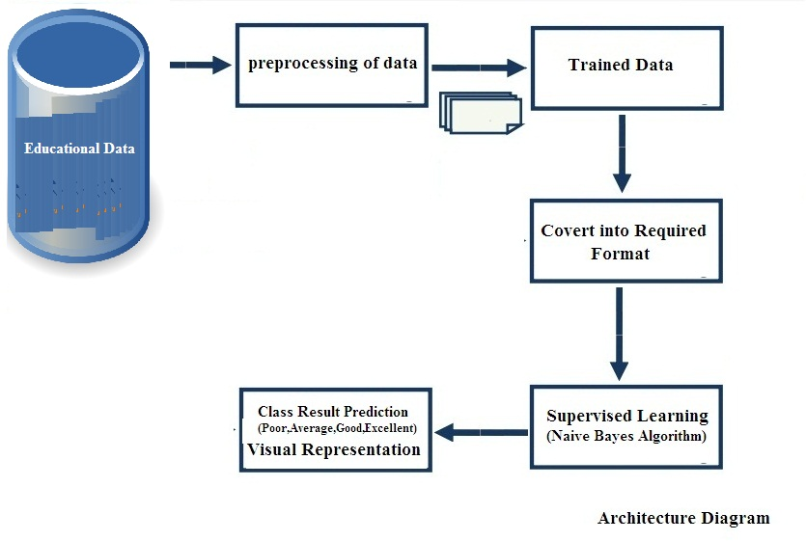
ARCHITECTURE DIAGRAM

Slide 14
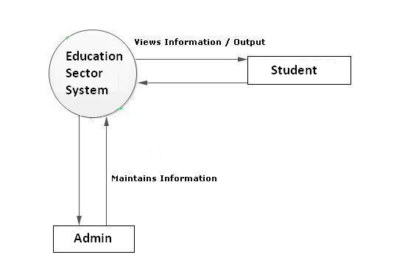
CONTEXT FLOW DIAGRAM

Slide 15
REFERENCES
Andreas C. Müller, Sarah Guido. Introduction to Machine Learning with Python. O'Reilly Media, September 2016.
Naive Bayes classifier, from Wikipedia, the free encyclopaedia. https://en.wikipedia.org/wiki/Naive_Bayes_classifier 2017 International Conference on Smart Technology for Smart Nation 1211
Micheal Bowles, Machine Learning in Python: Essential Techniques for Predictive Analysis. John Wiley & Sons, Inc. 2015

Slide 16
THANK YOU

